Slide 1
Data Analytics
Data Wrangling using Python

Slide 2
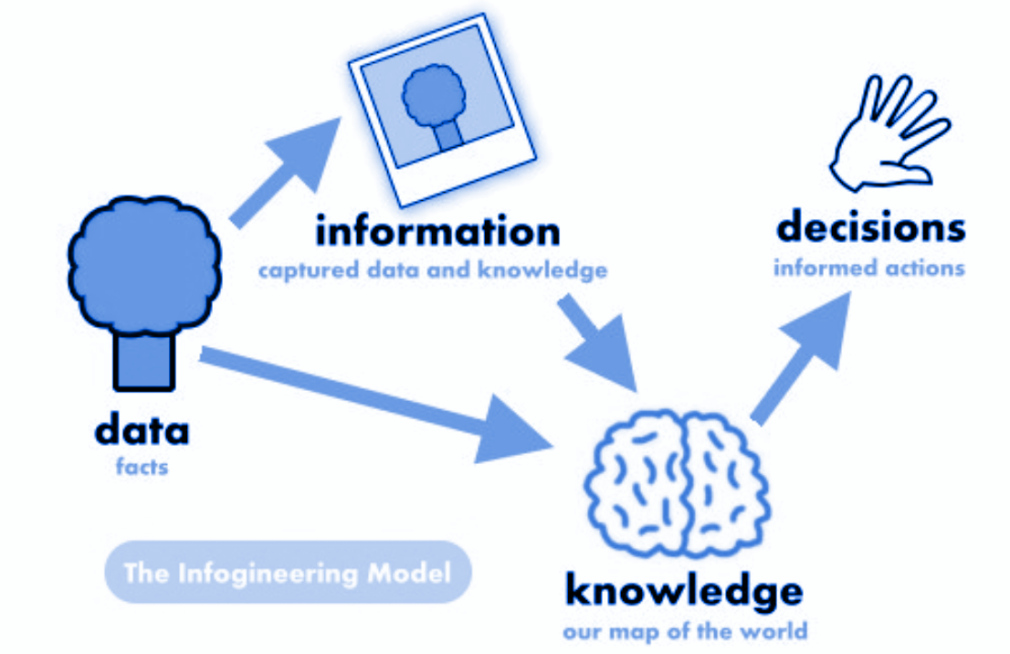
Data Science
The Problem
Data is everywhere
Data does not mean information
Data Science helps unlock information from raw data to answer questions.

Slide 3
Data Wrangling?
Data Wrangling is the process of gathering, collecting, and transforming Raw data into another format for:
Better understanding.
Decision-making.
Accessing, and
Analysis in less time.
Data Wrangling is also known as Data Munging.
Gather
Select
Transform

Slide 4



Python Data Science Package
Scientific Computing Libraries:
Pandas: Data structure & tools.
NumPy: Arrays & Matrices.
SciPy: Functions for advanced math problems.

Slide 5


Visualization
Visualization Libraries:
Matplotlib: Plots & graphs
Seaborn: Heat maps, time series, violin plots

Slide 6


ML Models
Algorithmic Libraries (ML Tasks)
Scikit-learn: ML: Regression, classification, etc.
Statsmodel: Explore data, statistical models, and tests

Slide 7
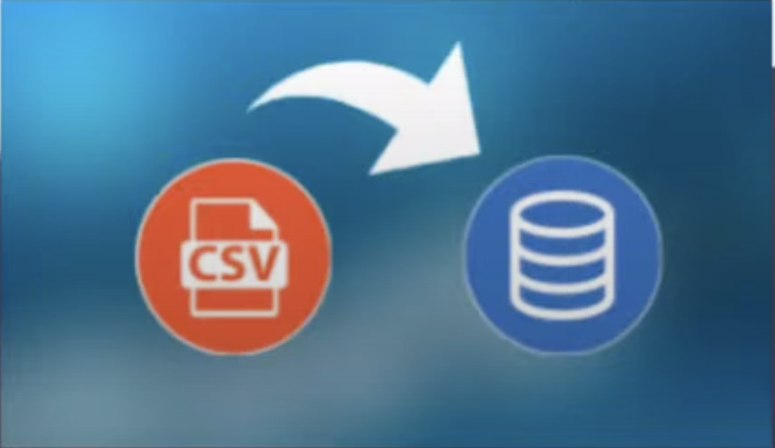
Let’s import some data

Slide 8
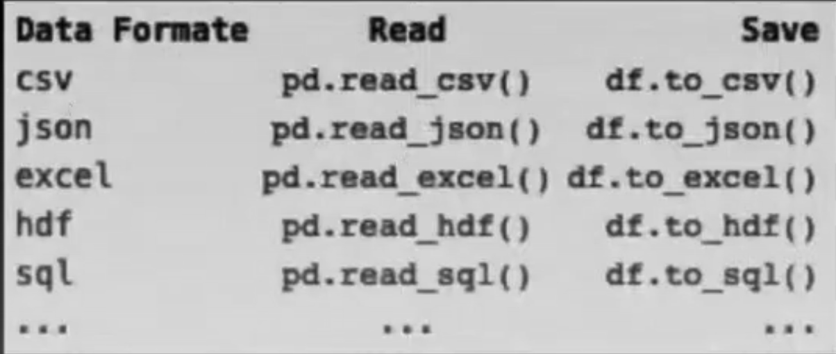
Importing Dataset

Slide 9


Slide 10
Cleaning Data
Identify Missing Data
Deal with Missing Data
Correct Data Formats
Convert? to NaN
Drop or replace?
int, float,text and other
1
2
3

Slide 11
Transforming Data
Standardization:
Common format for meaningful comparison
Normalization:
Transforming to the similar range
Binning:
Continuous – Numerical
Discrete – Categorical

Slide 12
Exploratory Data Analysis
Summarize main characteristics of the data
Gain better understanding of the dataset
Uncover relationship between variables
Extract important variables

Slide 13
Grouping
Analysis can be made on grouped data
Example: Average price per drive-wheel type

